Slide 1
REALTORS® ASSOCIATION OF
NEW MEXICO
LEGAL UPDATE
Presented By:
Ashley Strauss-Martin, Esq.
November, 2016

Slide 2
TOPICS COVERED TODAY
NM REC ADOPTED RULES
NEW/REVISED RANM FORMS
    LISTING AGREEMENT
    BUYER’S SALE CONTINGENCY
    BACK-UP CONTRACT (OFFER)
    TENANT CONSENT FOR PHOTOS AND OPEN HOUSE
    SERVICE/THERAPY ANIMALS INFO SHEET
    FIRPTA

Slide 3
TOPICS COVERED TODAY
STATE/HOT LINE ISSUES
  AUCTIONS
  TITLE INSURANCE ON RECs
  PERSONAL INJURY COVERAGE
  FHA - ELIGIBILITY DISCLOSURE
  BUILDING PERMITS
  SOLAR PANELS

Slide 4
TOPICS COVERED TODAY
NATIONAL ISSUES:
  DEPT. OF LABOR RULES
  NEW DRONE REGS
  FHA CONDO RULES
  FHAA DISPARATE IMPACT GUIDANCE
  RESPA – SECTION 9
  WIRE FRAUD

Slide 5
CASE LAW
  CFPB – UNCONSTITUTIONAL ??
  NM Court of Appeals Case – Broker Negligence
  Duty To Disclose Foul Odor
  Failure To Disclose Buyer’s Reasons For Purchasing Property
  Duty To Disclose Off-Site Conditions
  Buyer Broker Agreement Enforced

Slide 6
REC ADOPTED RULES
EXCEPT FOR NEW BROKER DUTIES – 16.61.9.8,
ALL NEW RULES TAKE EFFECT JAN. 1, 2017

Slide 7
EDUCATION
CE INCREASED FROM 30 TO 36 HRS PER LICENSING CYCLE (EVERY 3 YRS)
MUST INCLUDE REC APPROVED
  (4 HR) ETHICS CLASS ONCE DURING EACH 3 –YR LICENSING CYCLE – NAR 2.5/2 YRS (2017)
  4 HR CORE ELECTIVE COURSE ONCE DURING EACH 3 –YR LICENSING CYCLE, AND
  4 HR CORE COURSE ANNUALLY DURING EACH OF THE 3 YEARS OF THE LICENSING CYCLE

Slide 8
EDUCATION
If Broker Takes Mandatory On Or Before December 31, 2016, Broker Will NOT Have To Take Core Course Until Next Licensing Cycle
BROKERS RENEWING AFTER DEC. 31, 2016 WILL BE REQUIRED TO HAVE 36 HOURS WHEN THEY RENEW!!

Slide 9
EDUCATION
  Mandatory Course Will Not Be Offered After Dec. 31, 2016.
  Brokers Who Have Taken Mandatory Course And Who Wish To Take The New Core Course, Will Receive 4 Additional Hours Of Education In Their Current Licensing Cycle

Slide 10
EDUCATION
  CORE COURSE – Covers…..
    Broker Duties
    E and O claims
    Laws and Regulations AND
    Disciplinary Case Studies

Slide 11
EDUCATION
  CORE ELECTIVE COURSE –
    Residential Sales OR
    Commercial Sales OR
    Vacant Land/Ranch Sales OR
    Property Management

Slide 12
REC ADOPTED RULES
DEFINITIONS:
  Clarification that a (Residential) Property Manager is an Agent of the Owner
  Broker Duties: “Certain Duties Owed To Customers, Clients, Other Parties To The Transaction And Other Brokers

Slide 13
DELAYED ADOPTION OF BROKER DUTIES
BROKER DUTIES – 16.61.19.8
  DO NOT TAKE EFFECT JAN. 1, 2017
  NEW BROKER DUTY LANGUAGE PUBLISHED IN DECEMBER AND CONSIDERED AT JAN. MEETING OF REC

Slide 14
DELAYED ADOPTION
BROKER DUTIES TO CUSTOMER, CLIENTS – ADDED:
Honesty, reasonable care, and ethical and professional conduct

Slide 15
BUT DEFINITION EFFECTIVE 1.1.17
DEFINITION OF HONESTY AND REASONABLE CARE AND ETHICAL AND PROFESSIONAL CONDUCT:
  conduct that a reasonable person would understand to meet standards of professionalism and ethical conduct within a profession, including but not limited to good faith, competence, trustworthiness, diligence, and lawful behavior.

Slide 16
DELAYED ADOPTION
BROKERS DUTIES TO TENANTS:
  Honesty, reasonable care, and ethical and professional conduct
  Compliance with local state, and federal fair housing and anti-discrimination laws, the NM real estate license law and the REC rules, the NM Uniform Resident Relations Act, and other applicable local, state, and federal laws and regulations.

Slide 17
DELAYED ADOPTION
Brokers Duties to Tenants:
  Performance of any and all written agreements entered into with the tenant
  Prompt accounting for all money or property received by the broker from the tenant, including issuance of a receipt for cash received
  Written disclosure that the broker is the agent of the owner of the property and not of the tenant.

Slide 18
DELAYED ADOPTION
Brokers Duties to Tenants:
  Written disclosure of any adverse material facts actually known by the broker about the property or the transaction, or about the financial ability of the parties to the transaction to complete the transaction;
  Adverse material facts do not include any information covered by federal fair housing laws or the NM Human Rights Act.

Slide 19
DELAYED ADOPTION
  Broker Duties to Tenants
    Advice to tenants to consult an attorney regarding the effectiveness, validity, or consequences of any express written agreement the tenant is required to sign.

Slide 20
DELAYED ADOPTION
  BROKERS DUTIES
  TO OTHER BROKERS
    Honesty, reasonable care, and ethical and professional conduct
    Timely presentation of and response to all offers or counter-offers

Slide 21
DELAYED ADOPTION
  BROKERS DUTIES
  TO OTHER BROKERS
    participation in assisting their customer or client in complying with the terms and conditions of the contract and with the closing of the transaction;

Slide 22
DELAYED ADOPTION
  BROKERS DUTIES TO OTHER BROKERS
    local state, and federal fair housing and anti-discrimination laws, the New Mexico real estate license law and the REC rules, the NM Uniform Resident Relations Act, and other applicable local, state, and federal laws and regulations.

Slide 23
DELAYED ADOPTION
BROKERS DUTIES TO OTHER BROKERS
  Disclosure of any adverse material facts actually known by the AB or QB about the property or the transaction, or about the financial ability of the parties to the transaction to complete the transaction; adverse material facts requiring disclosure do not include any information covered by federal fair housing laws or the NM Human Rights Act;

Slide 24
DELAYED ADOPTION - BROKERS DUTIES TO OTHER BROKERS
disclosure to other brokers involved in the transaction of any potential conflict of interest that the broker has in the transaction including but not limited to:
  any written brokerage relationship the broker has with any other parties to the transaction;
  OR any material interest or relationship of a business, personal, or family nature that the broker has in the transaction;

Slide 25
DELAYED ADOPTION - BROKERS DUTIES TO OTHER BROKERS
  Non-interference with a purchase agreement or any express written agreement that another broker has with their client or customer.

Slide 26
RESPONSIBILITIES OF QB
Ensure that the QB name and contact information, including license number, is clearly and conspicuously displayed on any written document generated by the brokerage or presented to a prospective customer or client, AND that has the potential to become an express written agreement

Slide 27
        MANAGEMENT AGREEMENTS
          If the property manager is prohibited by law or contract from providing the owner with a given document, such as a tenant’s criminal background check or credit report, the property management agreement shall include the following:

Slide 28
        MANAGEMENT AGREEMENTS
          a written disclosure to the owner that the PM is prohibited by law or contract from providing such documents to the owner, and
          the owner’s written consent that such documents will not be provided.

Slide 29
MANAGEMENT AGREEMENTS
          Shall specify that the brokerage relationship between the property manager and the owner is an agency relationship.
          Shall define duties and responsibilities of broker and owner - ADDED
            Disclosure of the status of any default or other financial situation that could affect the tenant’s residency.

Slide 30
ADVERTISEMENTS
          Brokerage office telephone number shall be prominently displayed in a type size not less than 33 percent of the AB’s name, or in the case of a team of ABs, the team name

Slide 31
        ADVERTISEMENTS
          In the event that disclosure of the brokerage name and telephone number as registered with the Commission is not practical in electronic displays of limited information, such as “thumbnails”, text messages, links and “tweets” of 200 characters or less, such displays are exempt from the disclosure requirement provided such displays are linked to a display that includes all of the required disclosures.

Slide 32
RANM FORMS
LISTING AGREEMENT EXCLUSIVE RIGHT
TO SELL
FORM 1106

Slide 33
RANM FORMS
COVER PAGE II - BROKERAGE RELATIONSHIPS DISCLOSURE
  Transaction broker: Defined
  Exclusive agency: Defined
  Dual agency: Defined

Slide 34
LISTING AGREEMENT
ADDED TO PROPERTY - PARA. 3
  OTHER RIGHTS. Unless otherwise provided herein, Seller shall convey to Buyer all existing wind, solar, water and mineral rights appurtenant to the Property.
  Is Seller aware of any wind, solar, water or mineral rights that have been severed from the Property □ Yes □ No If “Yes”, explain

Slide 35
LISTING AGREEMENT
ADDED TO PROPERTY - PARA. 3
  LIST OF AFFIXED AND PERSONAL PROPERTY (AND SPACE TO LIST EXCLUSIONS) FROM RESIDENTIAL PURCHASE AGREEMENT

Slide 36
LISTING AGREEMENT
NEW PARA. 4 – THIS SECTION TO BE COMPLETED ONLY IF PROPERTY WILL NOT BE ENTERED INTO THE MULTIPLE LISTING SERVICE (MLS) WITHIN 48 HOURS OF THE BEGINNING TERM DATE SET FORTH IN PARAGRAPH 2. Check applicable provision.

Slide 37
LISTING AGREEMENT
  □ Broker shall not market Property through the MLS.
  □ Broker shall begin marketing the Property in the MLS within 48 hours of ________________ (DATE) or ______________________________________________________________(Event would be entered here)

Slide 38
LISTING AGREEMENT
  Seller acknowledges that Seller has been informed of the marketing benefits of the MLS and Seller hereby waives such marketing benefits as set forth in this Paragraph 4. NOTE: BROKER’S MLS MAY REQUIRE SELLER TO COMPLETE A WAIVER OF MLS BENEFITS. FOR MORE INFORMATION ON MLS BENEFITS, SEE RANM FORM 1820 - MLS INFORMATION SHEET.
______ Seller’s Initials

Slide 39
LISTING AGREEMENT
OWNER’S AUTHORIZATIONS: NEW
Material Authorizations. the following owner’s authorizations serve as material inducement for formation of this agreement and may not be withdrawn without broker’s written consent. owner’s attempt at non-compliance with this provision constitutes interference with broker’s ability to perform under this agreement and a material default of this agreement, which entitles broker to all remedies available through law and/or equity.

Slide 40
CAN’T BE CHANGED WITHOUT BROKER’S CONSENT
PLACE IN MLS
INTERNET
PLACE A FOR SALE/LEASE SIGN ON PROPERTY
LOCKBOX INSTALLATION
BROKER OBTAIN INFO ON PROPERTY
INCLUDE INTERIOR PHOTOS/VIDEO
OTHER

Slide 41
LOCKBOX
WHAT IS A LOCKBOX - A lockbox is a locked container on the Property in which a key is placed. The lockbox may be opened by a key, combination, or programmer key, permitting access to the Property.
WHO HAS ACCESS TO LOCKBOX - Seller acknowledges that a lockbox and any other keys left with or available to Broker will permit access to the Property by Broker or any other broker, with or without potential purchasers or tenants even when Seller or occupant is absent.

Slide 42
LOCKBOX
UNAUTHORIZED PERSONS - Seller further acknowledges that, from time to time, unauthorized persons may have gained access to properties using lockboxes.
NO LIABILITY - Seller acknowledges that neither the Brokerage, Broker, nor any Board or Association of REALTORS® is insuring Seller or occupant against theft, loss or vandalism resulting from any such access.

Slide 43
LOCKBOX
SELLER GUARD VALUABLES - Seller is responsible for taking such steps as may be necessary to secure and protect the Property and its contents during any time that a lockbox is being used.

Slide 44
KEYS
BROKER TO PROVIDE KEYS - to other Brokers and Agents and other authorized personnel to show the Property and to permit access for marketing and inspections.

Slide 45
LISTING AGREEMENT
CAN BE CHANGED WITHOUT BROKER’S CONSENT - WITH WRITTEN NOTICE TO BROKER
  DIVULGING TERMS AND/OR CONDITIONS OF OFFERS
  BLOGGING
  AVMs

Slide 46
LISTING AGREEMENT
NEW PARA. 9. - TENANT OCCUPIED PROPERTY.
If Property is currently tenant-occupied, then Seller must obtain written consent from Tenant for the following: (Tenant’s Consent – RANM Form 2110):

Slide 47
LISTING AGREEMENT
  to photo/video the inside of the Property and provide such authorization to Broker. If Seller is unable to obtain such authorization, Broker shall not photo or video the inside; AND
  to hold an “Open House” to allow prospective Buyers to inspect the premises. If Seller is unable to obtain such authorization, Broker shall not hold an “Open House” of the Property. NOTE: Tenant’s grant of consent allowing Broker to hold an “Open House” does not obligate Broker to do so.

Slide 48
LISTING AGREEMENT
COMPENSATION PARAGRAPH
  GRT Location Code ___________ ( to be completed by Broker)
  Based on Property Location
  NMREALTOR.COM – GRT location code map (bottom of Resources Tab – “RECOMMENDED” map)

Slide 49
LISTING AGREEMENT
COMPENSATION PARAGRAPH - NEW
Compensation due if at ANY time, a Buyer who obtained an option to purchase during the term of this Agreement exercises that option. This provision WILL NOT terminate if Seller enters into a written exclusive listing agreement with another licensed real estate broker.

Slide 50
LISTING AGREEMENT
Protection Period - It shall not be necessary to provide the name(s) of any buyer who has made an offer to purchase or lease the Property.

Slide 51
LISTING AGREEMENT
NEW PARA. 12 - COMPENSATION FOR LEASE.
  AMOUNT PLUS GRT
  PROTECTION PERIOD
  AUTHORIZATION TO SHARE COMPENSATION
  NO PROPERTY MANAGEMENT CREATED

Slide 52
LISTING AGREEMENT
ADDED TO WARRANTIES:
  Maintain Insurance
  All Seller-provided information is accurate
  All material defects disclosed to Broker
  Listing Content does not infringe

Slide 53
LISTING AGREEMENT
      USE OF LISTING CONTENT; INTELLECTUAL PROPERTY LICENSE.
        Owner acknowledges and agrees all photographs, images, graphics, video recordings, virtual tours, drawings, written descriptions, remarks, narratives, pricing information, and other copyrightable elements relating to the Property provided by Owner to Broker (the “Owner Listing Content”), or otherwise obtained or produced by Broker in connection with this Agreement (the “Broker Listing Content”),

Slide 54
LISTING AGREEMENT
      Owner Listing Content or the Broker Listing Content, may be filed with one or more multiple listing services, included in compilations of listings, and otherwise distributed, publicly displayed and reproduced, subject to the limitations listed in Section 8 of this Agreement

Slide 55
LISTING AGREEMENT
        Owner hereby grants to Broker a non-exclusive, irrevocable, worldwide, royalty free LICENSE to use, sublicense through multiple tiers, publish, display, and reproduce the Owner Listing Content, to prepare derivative works of the Owner Listing Content, and to distribute the Owner Listing Content or any derivative works thereof, subject to the limitations listed in Section 8 of this Agreement.

Slide 56
LISTING AGREEMENT
This non-exclusive license shall survive the termination of this Agreement for any reason whatever. Owner represents and warrants to Broker that the Owner Listing Content, and the license granted to Broker for the Owner Listing Content, do not violate or infringe upon the rights, including any copyright rights, of any person or entity.

Slide 57
LISTING AGREEMENT
Owner acknowledges and agrees that as between Owner and Broker, all Broker Listing Content is owned exclusively by Broker, and Owner has no right, title or interest in or to any Broker Listing Content .

Slide 58
LISTING AGREEMENT
. Seller Representation
  Bankruptcy? □ Yes □ No
  Loan modification? □ Yes □ No
  If yes to either, Seller should determine what, if any implications, such bankruptcy and/or loan modification may have on the sale of the Property
  Option to Purchase □ Yes □ No. If yes, provide a copy of the Option to Purchase.

Slide 59
LISTING AGREEMENT
  OWNER INDEMNIFICATION:
    incorrect or undisclosed information about the Property which Owner knew or should have known;
    injury to third-parties occurring at the Property provided such injury is not due to Broker’s own negligent, reckless or intentional action; and
    infringement of any copyright arising out of Broker’s use of Owner Listing Content.

Slide 60
LISTING AGREEMENT
Added
  Electronic signature consent
Modified – so language is the same as in the purchase and other agreements
  Attorney fees and costs
  Governing law and venue
  Severability

Slide 61
BUYER’S SALE CONTINGENCY

Slide 62
BUYER’S SALE CONTINGENCY
INTENDED PURPOSE.
  the Buyer is making an offer on the Seller’s property; and
  the Buyer is attempting to sell his existing property; and
  the Buyer is making his offer to purchase Seller’s property subject to the sale, closing and funding of his property; and
  the Seller agrees to discontinue MLS marketing of the his property once the Buyer’s property goes under contract.

Slide 63
BUYER’S SALE CONTINGENCY
The term “satisfies” and any variation thereof means that the Buyer has closed on the sale of his property.
The term “waives” and any variation thereof means that it is no longer necessary for the Buyer to sell his property in order to purchase the Seller’s property. If the Buyer “waives” this Contingency, the Buyer is no longer making the purchase of the Seller’s property contingent on the Buyer first selling his own property.

Slide 64
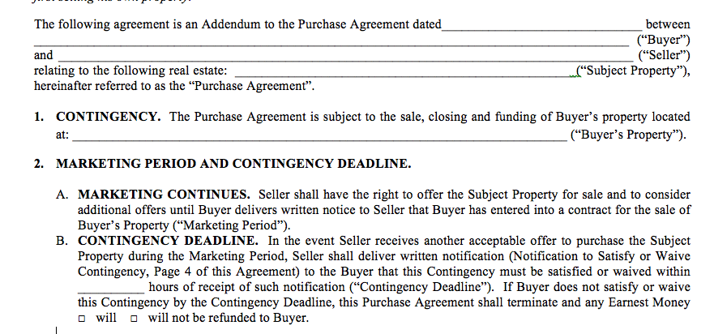
BUYER’S SALE CONTINGENCY

Slide 65
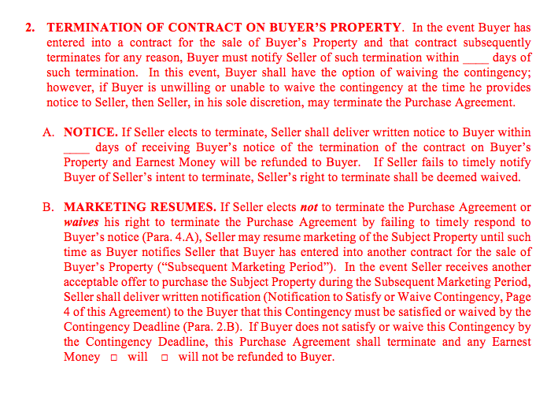
BUYER’S SALE CONTINGENCY

Slide 66
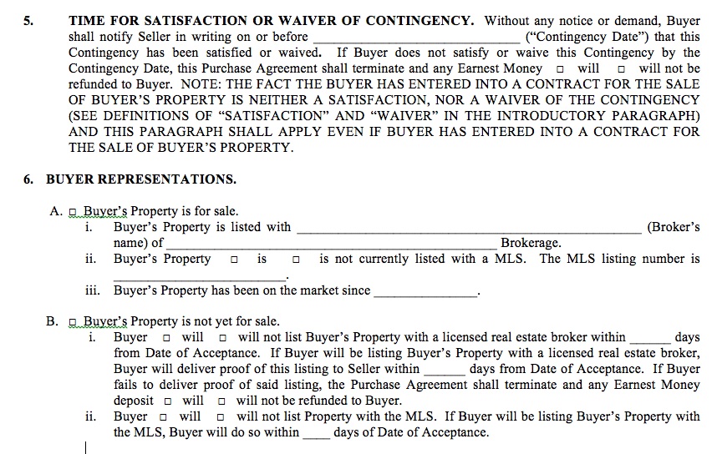
BUYER’S SALE CONTINGENCY

Slide 67
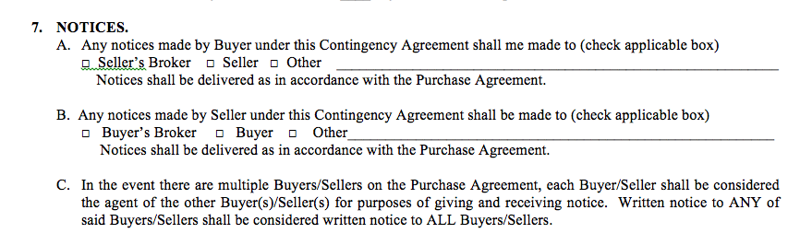
BUYER’S SALE CONTINGENCY

Slide 68
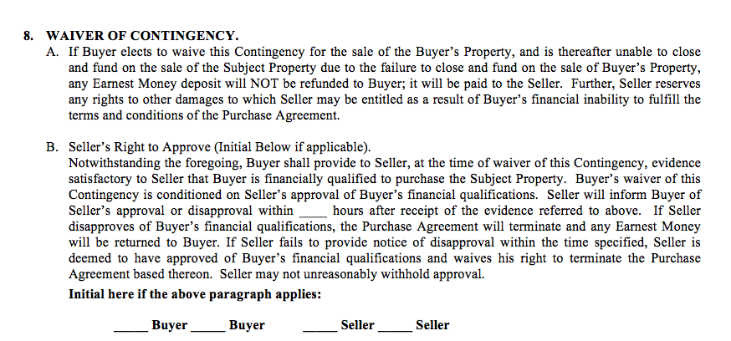
BUYER’S SALE CONTINGENCY

Slide 69
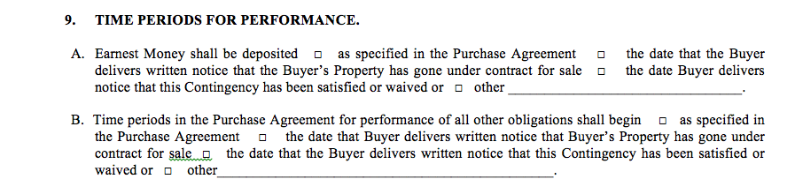
BUYER’S SALE CONTINGENCY

Slide 70
ADDENDUM FOR
BACK-UP PURCHASE AGREEMENT

Slide 71
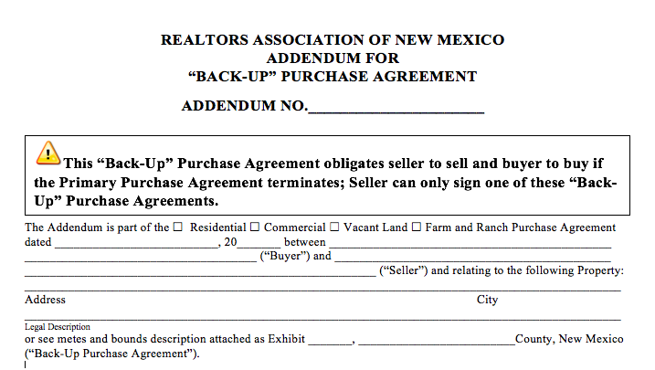
ADDENDUM FOR BACK-UP PA

Slide 72
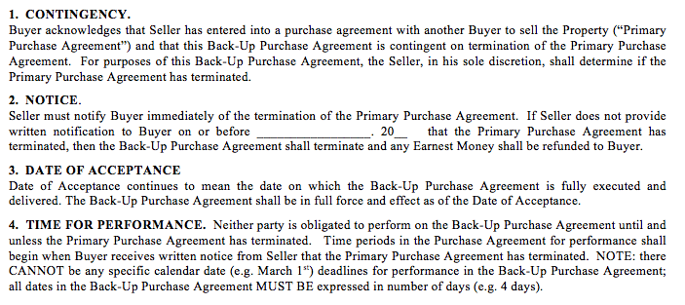
ADDENDUM FOR BACK-UP PA

Slide 73
TENANT
PHOTO/VIDEO
AND OPEN HOUSE CONSENT

Slide 74
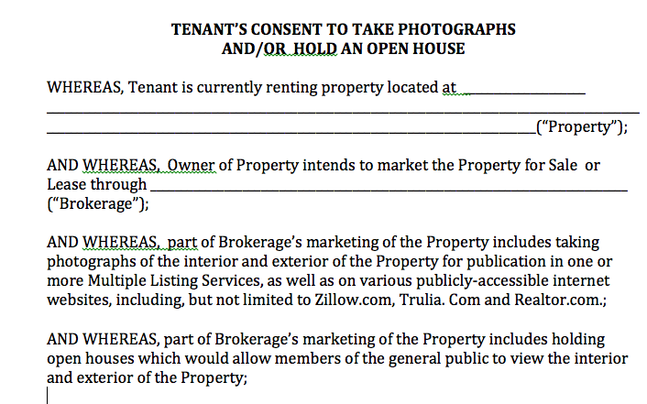
TENANT CONSENT FORM

Slide 75
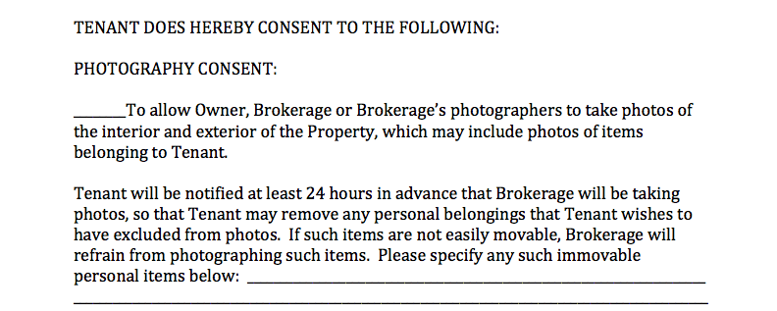
TENANT CONSENT FORM

Slide 76
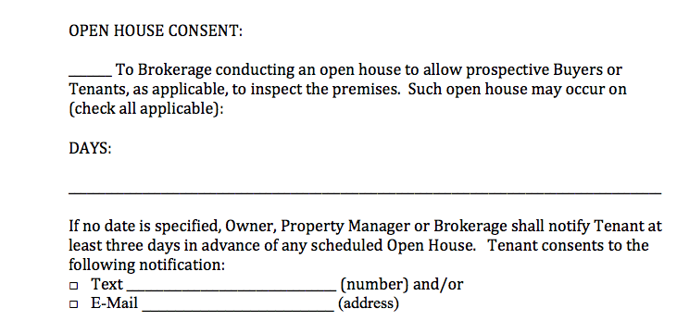
TENANT CONSENT FORM

Slide 77
SERVICE AND THERAPY ANIMALS
IN PRIVATELY-OWNED
RENTAL PROPERTY
INFORMATION SHEET

Slide 78
INFO SHEET
Applicable Anti–Discrimination Laws
Service and Therapy Animals
“No Pet” Polices
Request for Reasonable Accommodation
Vaccinations
Denying a Request for Reasonable Accommodation
Damage Caused by Assistance Animal

Slide 79
FIRPTA
DETERMINING WITHHOLDING RATE.
If all 3 apply, then the rate is 10%:
  Sales prices exceeds $300,000, but does not exceed $1,000,000; AND
  Property will be used by the buyer as a primary residence; AND
  Buyer is an individual.

Slide 80
FIRPTA
  If under $300,000, but not used as primary residence, withholding is 15%
  If between $300,000 and $1 mil., but buyer is not an individual OR not using as a primary residence, then the withholding rate is 15% If exceeds $1,000,000, then withholding rate is 15% regardless of the type of buyer or the buyer’s intended use for the property.

Slide 81
ODDS AND ENDS
  AUCTIONS
  TITLE INSURANCE ON RECs
  PERSONAL INJURY COVERAGE
  FHA - ELIGIBILITY DISCLOSURE
  BUILDING PERMITS
  RESPA – SECTION 9
  SOLAR PANELS

Slide 82
NATIONAL ISSUES
DEPT. OF LABOR RULES
  IF NO OVERTIME, EMPLOYEE MUST MAKE AT LEAST $47,476 ANNUALLY – INCREASED FROM $23,660
  AUTO UPDATES EVERY THREE YEARS
  MAY SATISFY UP TO 10% OF MINIMUM SALARY LEVEL WITH NON-DISCRETIONARY PAYMENTS, BONUSES AND COMMISSIONS – MUST BE MADE AT LEAST QUARTERLY
  EFFECTIVE DATE DEC. 1, 2016

Slide 83
NEW DRONE REGS
  SMALL UNMANNED AIRCRAFT SYSTEM (UAS)– LESS THAN 55 LBS.
  EFFECTIVE AUGUST 29, 2016
  REMOTE PILOT CERTIFICATE W/UAS CERTIFICATION – NO 333 WAIVER – NO PILOTS LICENSE REQUIRED
  VISUAL LINE OF SIGHT
  DAYLIGHT OPERATIONS ONLY
  NO OPERATIONS OVER PERSONS

Slide 84
  REMOTE PILOT CERTIFICATE
  at least 16 years old;
  able to read, write, and understand the English language;
  in a physical and mental condition that allows for the safe operation of UAS;
  pass an initial aeronautical knowledge test

Slide 85
BEST PRACTICES
Tell other people you’ll be taking pictures or video of them before you do.
If you think someone has a reasonable expectation of privacy, don’t violate that privacy by taking pictures, video, etc.
Don’t fly over other people’s private property without permission if avoidable.

Slide 86
FHA CONDO RULES
Reduces FHA condo owner-occupancy ratio to 35%, unless FHA takes alternative action within 90 days from Aug 24th
Directs FHA to streamline the condo re-certification process.
Provides more flexibility for mixed use buildings.
Directs FHA to allow small transfer fees

Slide 87
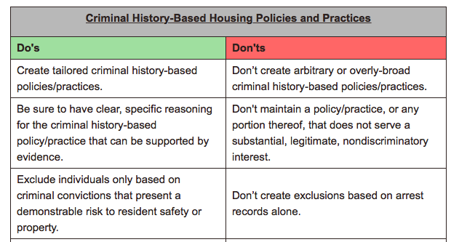
  FHAA DISPARATE
  IMPACT GUIDANCE

Slide 88
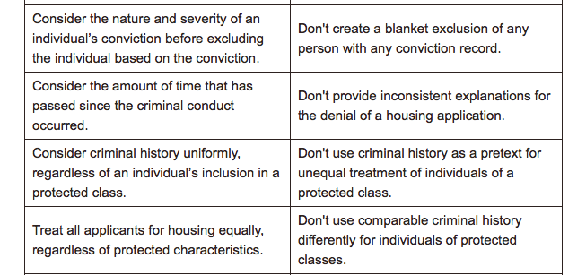
  FHAA DISPARATE
  IMPACT GUIDANCE

Slide 89
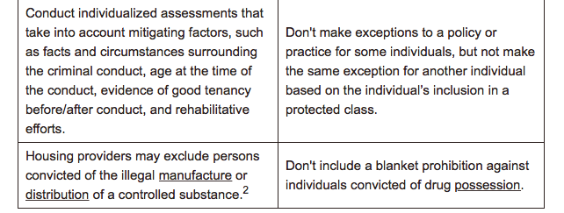
  FHAA DISPARATE
  IMPACT GUIDANCE

Slide 90
WIRE FRAUD ISSUES
  IMPORTANT NOTICE: Never trust wiring instructions sent via email. Cyber criminals are hacking email accounts and sending emails with fake wiring instructions. These emails are convincing and sophisticated. Always independently confirm wiring instructions in person or via a telephone call to a trusted and verified phone number. Never wire money without double-checking that the wiring instructions are correct.

Slide 91

CASE LAW
  WHAT ARE THE COURTS SAYING?

Slide 92
US CT. OF APPEALS
  PHH CORP. V. CFPB
  PHH Corp., a mortgage lender, accused of illegally referring consumers to mortgage insurers in exchange for kickbacks.
  Director Richard Codray’s final order prohibited PHH from violating the law and required PHH to pay $109 million to the CFPB

Slide 93
  PHH APPEALED FINE
  the court found that the CFPB’s current structure allows the director to wield far too much power, more than any other agency in the government
  the director of the CFPB is the “single most powerful official in the entire U.S. Government, other than the President,” in terms of unilateral power.

Slide 94
  U.S. CT. OF APPEALS
  Current power structure OF CFPB is UNCONSTITUTIONAL
  Result of the decision, the CFPB now will operate as an executive agency. The President of the United States now has the power to supervise and direct the Director of the CFPB, and may remove the Director at will at any time.

Slide 95
  U.S. CT. OF APPEALS
  REMANDED THE CASE TO THE CFPB TO DETERMINE WHETHER ANY MORTGAGE INSURERS PAID MORE THAN REASONABLE MARKET VALUE TO THE PHH-AFFILIATED REINSURER

Slide 96
  NM COURT OF APPEALS
  FACTS
    All Brokers Involved Worked For Same Brokerage
    Buyer Bob Represented By Broker “A” Bought Property With Restrictive Covenant – No Lots Smaller Than 5 Acres
    Broker Assured Buyer Bob He Could Subdivide And Neither Broker “A” Nor Buyer Bob Caught Restrictive Language In Covenants – No Lot Smaller Than 5 Acres
    Buyer Bob Bought And Subdivided Into 2.5 Acres, Built On One And Sold It

Slide 97
  NM COURT OF APPEALS
  While Building Second House On Second 2.5 Acre Lot, Title Company told Buyer Bob he was in Violation of Covenants
  Broker Said They Would Fix It And Encouraged Buyer Bob To Finish Building 2nd Home Brokerage Marketed Home Without Disclosing Violation
  The “Fix” - Brokerage Decided To Get Other Owners To Waive Objection And Consent To Amending Covenant

Slide 98
  NM COURT OF APPEALS
  Letter Said Covenant Was Expiring. It Didn’t Expire For 15 Years.
  Letter Said That Covenant Conflicted With The Character Of The Neighborhood. It Did Not.
  Indicated Owners Of 7 Lots Had Signed Waiver. The Owner Who Had Signed Had Since Sold The Lots And Current Owners Had Not Signed Waivers.
  Broker “A” Hand Delivered Letters And Attempted To Obtain Signatures
  Broker “A” Said He Was Representing A Friend And That He Didn’t Have A Stake In The Outcome

Slide 99
  NM COURT OF APPEALS
  Broker Got Neighbor #1 To Sign
  Neighbor #2 (COBB) Didn’t Agree And Brought Suit To Enforce Covenant
  Other brokers from same brokerage who knew of violation represented Buyer #2 (Simmons) Who Bought Neighbor #1’s House
  Didn’t Disclose to Simmons that Buyer Bob Was In Violation Of Covenant
  Didn’t Disclose To Simmons That Seller Had Signed An Agreement To Waive Enforcement of The Covenant

Slide 100
  NM COURT OF APPEALS
  After Simmons Purchased, Brokerage Tried To Get Simmons To Sell Buyer Bob Some Land Or To Waive Covenant
  Simmons Refused
  When Sued by Cobb, Defendant Buyer Bob Brought in All Property Owners, Incl. Simmons, Seeking To Bind Them To Decision In Case
  Simmons Counterclaimed For Breach Of Covenant Against Buyer Bob, Negligent Misrepresentation And Constructive Fraud Against Brokerage

Slide 101
  NM COURT OF APPEALS
  Trail Court Found For Cobb Against Buyer Bob And Broker - $311,931, plus punitive damages, plus attorney fees
  Also Found For Simmons Against Brokerage $452,287, plus attorney fees, post judgment interest and costs
  Buyer Bob And Broker Appealed

Slide 102
  NM COURT OF APPEALS
  After Appeal Was Filed, Parties Settled Cobb’s Claim Against Broker
  Appeal Was Dismissed Against Buyer Bob Because Buyer Bob Declared Bankruptcy And District Court’s Award against Buyer Bob Was Discharged in bankruptcy
  Simmons Claim Against Broker Remained

Slide 103
  NM COURT OF APPEALS
  Negligent Misrepresentation
    Material misrepresentation
    Buyer relied on representation
    Broker knew representation was false
    Broker intended to induce buyer to buy

Slide 104
  NM COURT OF APPEALS
    Requires a failure to exercise ordinary care in obtaining or communication a statement
    An intent that the plaintiff receive and be influenced by the statement where it is reasonably foreseeable that the plaintiff would be harmed if the information conveyed was incorrect or misleading
    Can be established by commission or OMISSION

Slide 105
  NM COURT OF APPEALS
    Broker should have disclosed to Simmons the violation and the fact that seller had signed a wavier of covenant
    Cited Broker Duties – Duty of honesty, reasonable care, and to Disclose Adverse Material Facts

Slide 106
  NM COURT OF APPEALS
    RANM PA – language that broker doesn’t warrant or guaranty condition of property……has not relied on statements made by broker” etc.
    Court said this does not alleviate duty to disclose material issues, and PA says that!

Slide 107
  NM COURT OF APPEALS
    Negligence Per Se
      Statute or reg which prescribes certain actions or defines standard of conduct
      Defendant violated
      Plaintiff was in the class of persons intended to be protected
      And harm was that which the legislature intended to prevent

Slide 108
  NM COURT OF APPEALS
    Reg – requires broker to disclose
    Broker didn’t disclose violation or the fact seller had signed waiver
    Simmons was the in the class of people intended to be protected
    And type of harm they suffered was harm the regulation was intended to prevent

Slide 109
  NM COURT OF APPEALS
    Damages Affirmed
      $123,000 for overpayment of lots
      $202,725 in commissions
      $126,562.95 in Carry Cost Damage
      $152,552.36 in attorney fees for defending and suit
    Damages affirmed accept
      adjustment – commission due, but not on $123,000
      Attorney fees on defense, but not counterclaim

Slide 110
CASE LAW - CA
  Buyer notices “foul” odor
  Broker says it’s “sea air”
  “Just replace sheetrock”
  After purchase, buyer noticed oil-like odor on first floor
  Investigated and found buried septic and oil tanks
  To fully remediate had to REMOVE ENTIRE HOUSE

Slide 111
CASE LAW
  WAS
  AGENT
  LIABLE?

Slide 112
CASE LAW - CA
  AGENT SETTLED FOR $275,000
  SELLER WENT TO COURT
    NO FRAUD, BUT NEGLIGENT MISREPRESENTATION FOR AGENT’S REMARKS
  QUESTION OF DAMAGES AND ATTORNEY FEES

Slide 113
CASE LAW- OH
  Buyer and Broker told owner “Buyer plans on raising livestock on land”
  Really Buyer wanted property for mineral rights and Broker knew this
  Mineral rights doubled value of property - $460 k to $2.1 mil
  Seller sued for fraudulent inducement, fraudulent misrepresentation and breach of FD

Slide 114
CASE LAW- OH
  Seller and buyer settled - $450 k
  Admissions said “broker had duty to advise the seller about buyer’s use and breached FD”
  Broker failed to answer requests for admissions
  Awarded $1.2 mil.

Slide 115
CASE LAW- NY
  During showing, prospective tenant tripped on curtain cord from open curtains and fell down stairs
  Broker could not remember if she opened curtains
  Prospective Tenant sued owner and broker

Slide 116
CASE LAW- NY
  Trial court found for broker – said broker is not responsible for injuries occurring on property during showing unless it can be shown that the real estate professional controlled the premises
  And no evidence that broker controlled the owner’s apartment which was rented at the time

Slide 117
CASE LAW- NY
  Appellate court reversed
  1st theory of liability: owner relied on performance of broker’s contractual duties that resulted in injuries - No contractual duty to open curtains
  2nd theory required broker to take control of the property – No control of apartment because tenant lived there

Slide 118
CASE LAW- NY
  3rd theory could impose liability if broker “launched the instrument of harm”.
  In this case, the curtain cord
  Back to trial court

Slide 119
CASE LAW- 3RD CIR.
  FAILURE OF DEVELOPER AND BROKER TO DISCLOSE TO A BUYER THE PRESENCE OF UNRULY NEIGHBOR
  BROKER SAID “NEIGHBOR IS NO PROBLEM”
  BUYER HAD TO GET RESTRAINING ORDER AGAINST NEIGHBOR

Slide 120
CASE LAW- 3RD CIR.
  NJ had duty to disclose off-site conditions that are material to transaction –
  But not to disclose social conditions
  No way to know neighbor was going to be hostile to buyer
  Trial court affirmed

Slide 121
CASE LAW- CONN.
  BUYER-BROKER AGREEMENT WITH BROKER #1
  BUYER ENTERED INTO ANOTHER BBA AND USED BROKER #2 TO BUY PROPERTY
  BROKER #1 FILED LIEN AGAINST BUYER’S PROPERTY
  BROKER WON!

Slide 122

RANM LEGAL HOT LINE
1-877-699-7266
LEGALHOTLINE@NMREALTOR.COM
MONDAY – FRIDAY
9:00 TO 1:00 PM

